Slide 1

Introduction to Cybersecurity
Presented by
Dhrish

Slide 2

Cyber Crime
Cyber crimes are, as the name implies, crimes committed using computers, phones or the internet.
Some types of cyber crime include:
Illegal interception of data.
System interferences.
Copyrights infringements.
Sale of illegal items.

Slide 3
Cyber Security
Zero-day attack, ransomware, alert fatigue and Man-in the middle attack are just a few examples of common cyber attacks.
Cyber security is the body of technologies, processes and practices involved in protecting individuals and organizations from cyber crime.
It is designed to protect integrity of networks, computers, programs and data from attack, damage or unauthorized access.

Slide 4
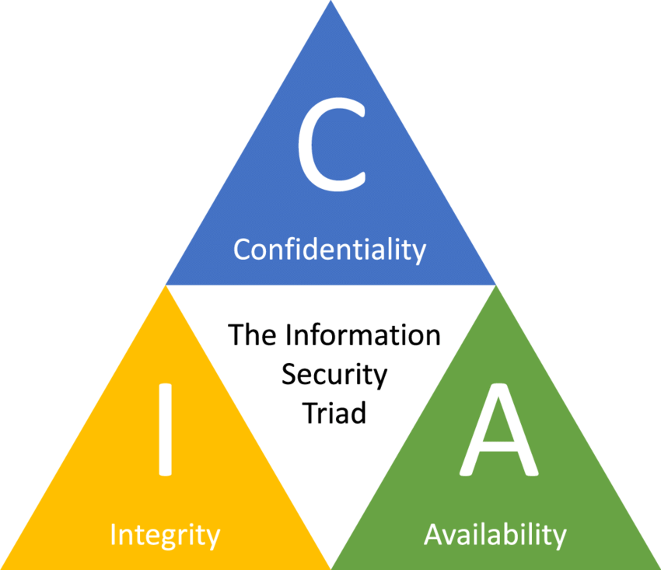
Cyber Security Principles
There are five key principles in cyber security:
Confidentiality
Integrity
Availability
Accountability
Auditability

Slide 5
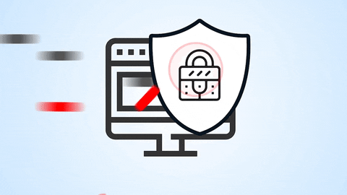
Cyber Security Principle Definitions
Confidentiality:
A set of rules that limits access or place restrictions on certain type of information.

Slide 6
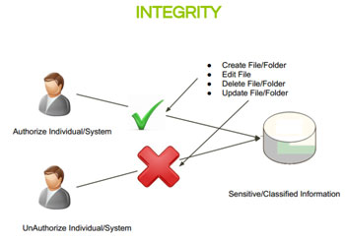
Cyber Security Principle Definitions
Integrity:
Assurance that the information is trustworthy and accurate.

Slide 7
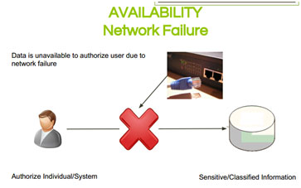
Cyber Security Principle Definitions
Availability:
The guarantee of reliable access to the information by authorized people.

Slide 8
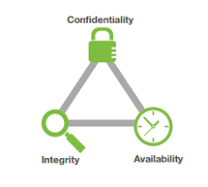
Cyber Security Principles
Confidentiality
Integrity
Availability

Slide 9
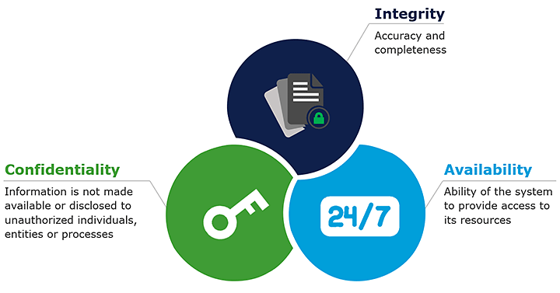
Cyber Security Principles

Slide 10

Cyber Security Principle Definitions
Accountability:
Is an assurance that an individual or an organization will be evaluated on their performance or behaviour related to something for which they are responsible.

Slide 11
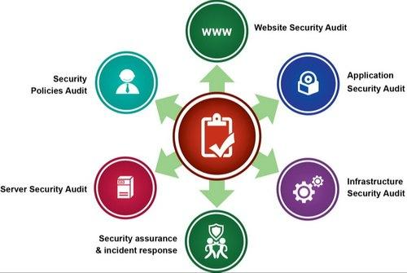
Cyber Security Principle Definitions
Auditability:
A security audit is a systematic evaluation of the security of a company’s information system by measuring how well it conforms to a set of established criteria.

Slide 12
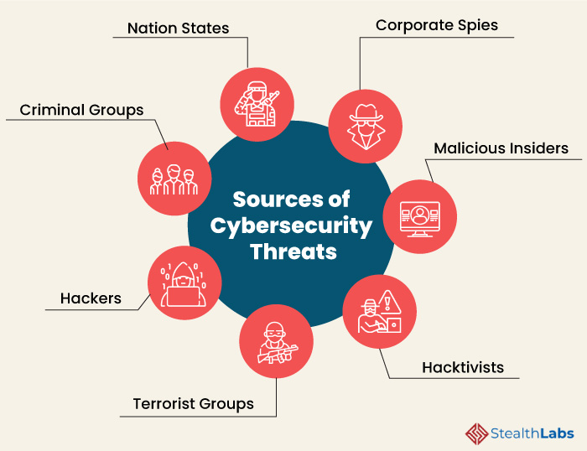
Cyber
Threats

Slide 13
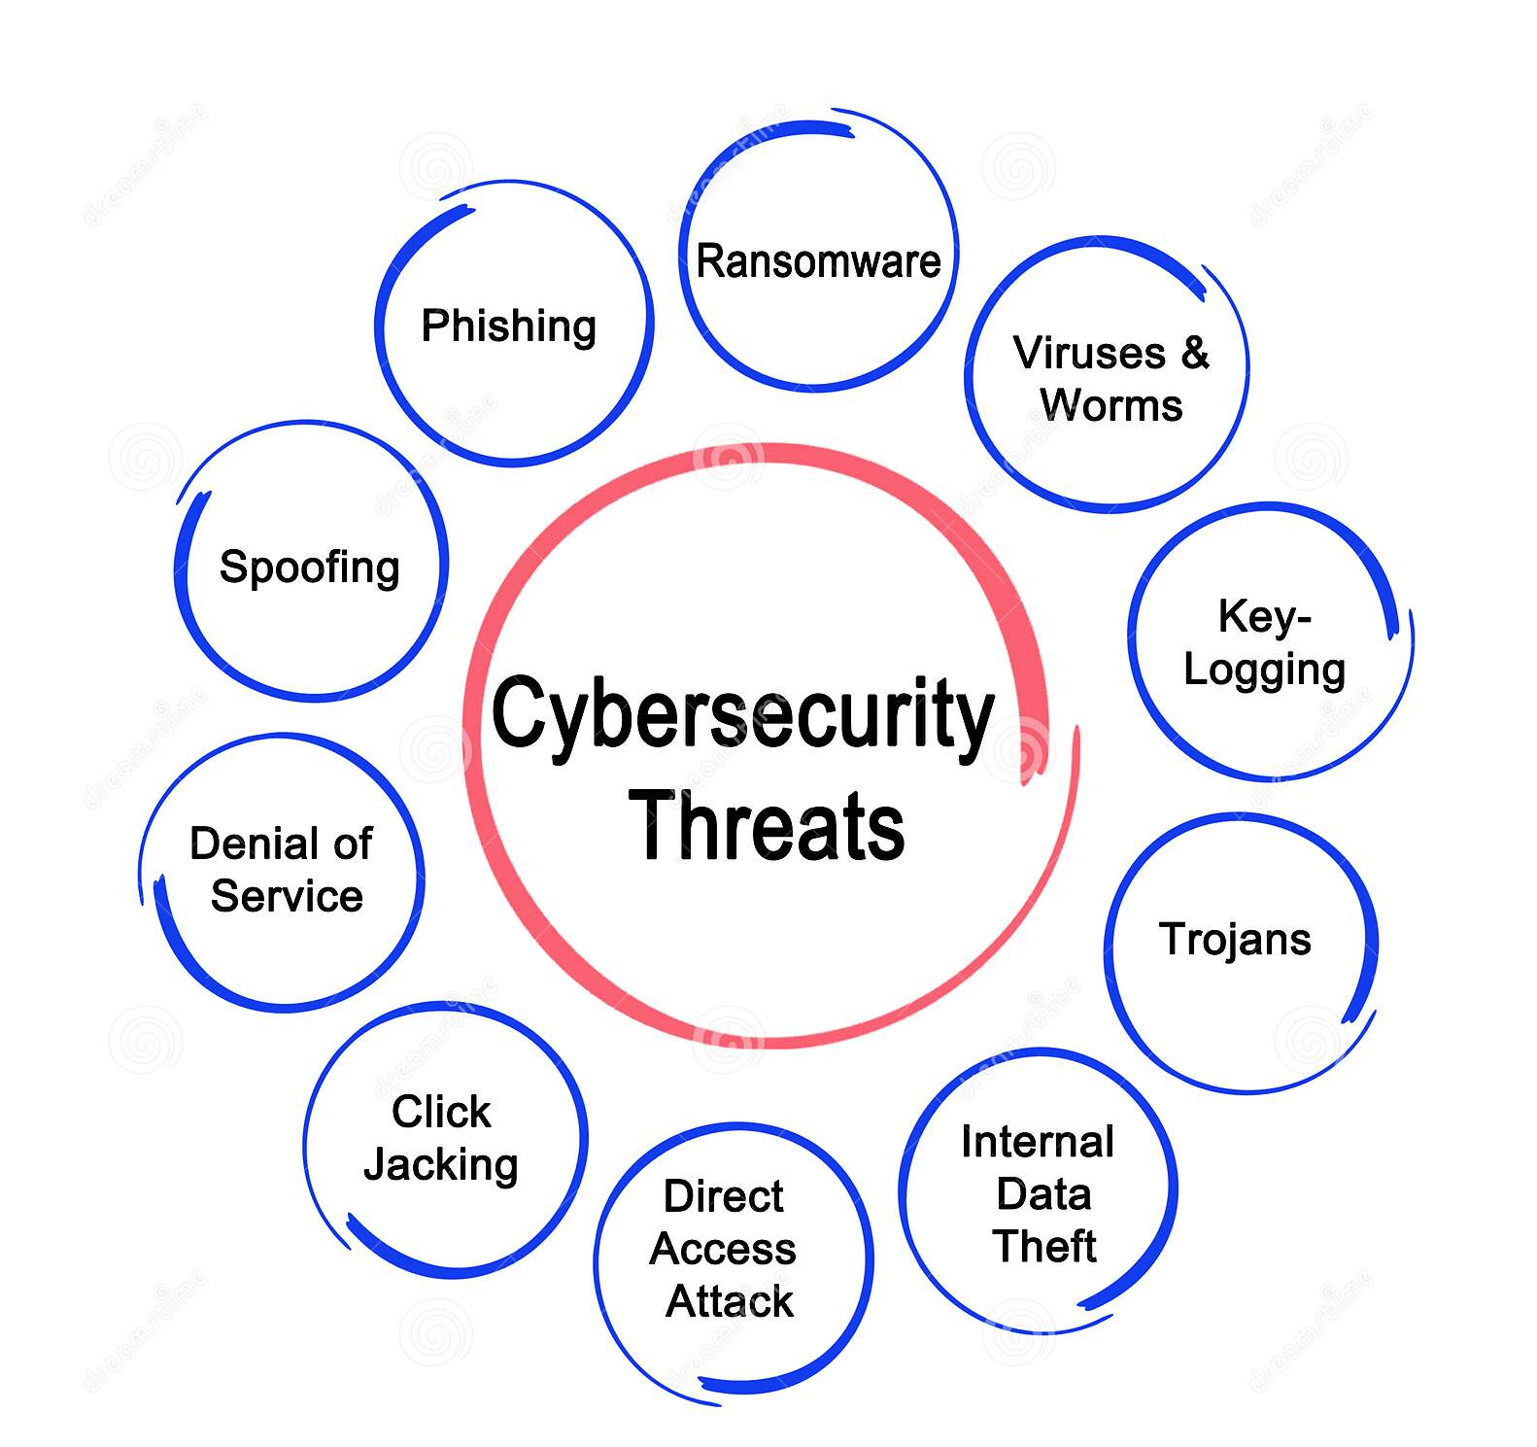
Cyber Threat
A Cyber threat is any malicious act that attempts to gain access to a computer network without authorization or permission from the owners.
It refers to the wide range of malicious activities that can damage or disrupt a computer system, a network or the information it contain.

Slide 14
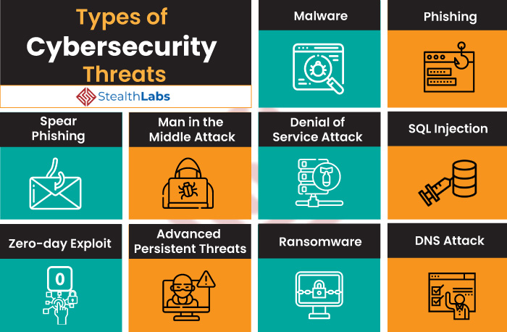

Slide 15
Sources of Cyber Threats
Anyone with a motive and the needed technology can create cyber threats.
Cyber threats can come from a wide variety of sources, some notable examples include:
National governments.
Terrorists.
Industrial secret agents.
Rogue employees.
Hackers.
Business competitors.
Organization insiders.

Slide 16
Cyber Threat Classifications
Threats can be classified by multiple criteria:
Attacker's Resources
Attacker's Organization
Attacker's Funding
On basis of these criteria, threats are of 3 types:
Unstructured Threats
Structured Threats
Highly Structured threats

Slide 17

Cyber Attacks

Slide 18
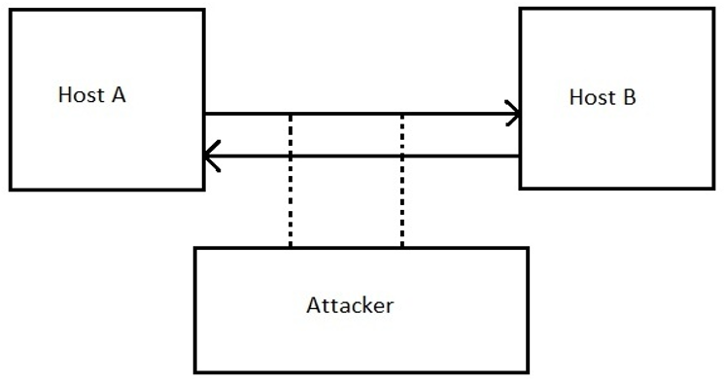
Cyber Security Attack

Slide 19
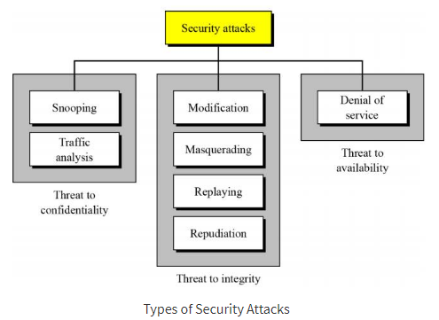
Security Attacks Types

Slide 20
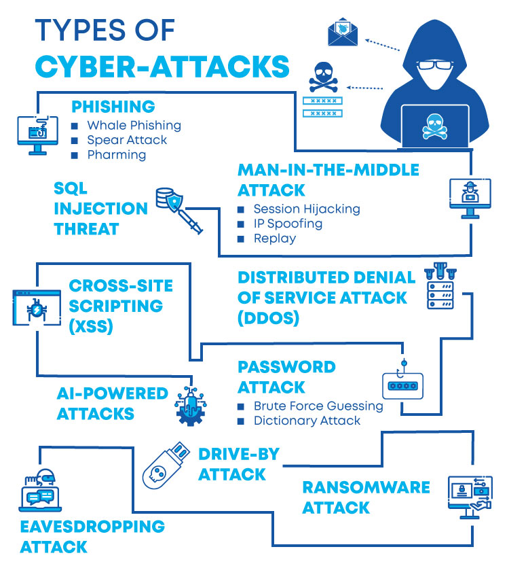

Slide 21
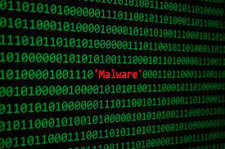
Malicious Code

Slide 22
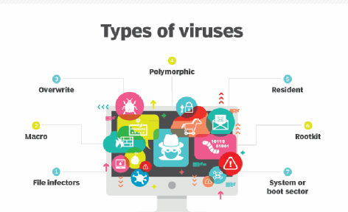
Types of Malicious Code
Virus:
Malicious software program, when it is executed, it replicates itself by modifying other computer programs and inserting its own code.

Slide 23
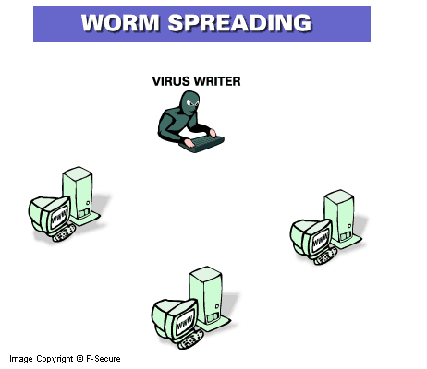
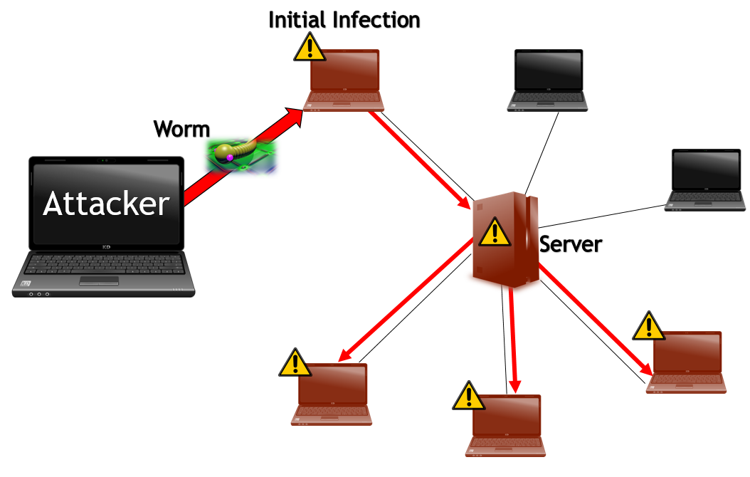
Types of Malicious Code
Network Worm:
Standalone malware which replicates itself in order to spread to other computers.

Slide 24
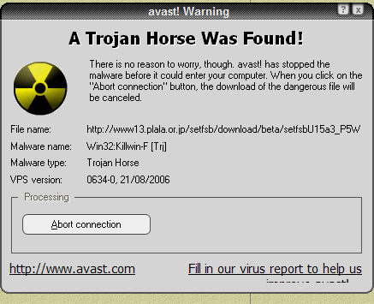
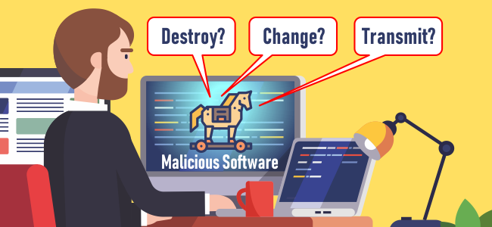
Types of Malicious Code Continued
Trojan Horse:
A program that claims to free your computer from viruses but instead introduces viruses onto your system.

Slide 25
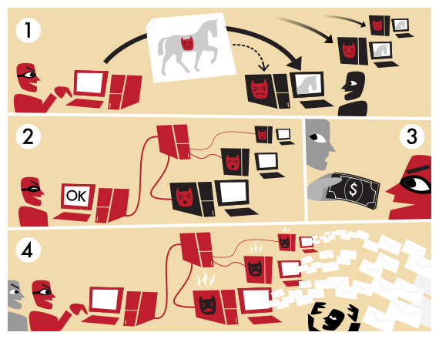
Types of Malicious Code Continued
Botnet:
Used to perform distributed denial-of-service attack (DDoS attack), steal data, send spam, and allow the attacker access to the device and its connection.

Slide 26

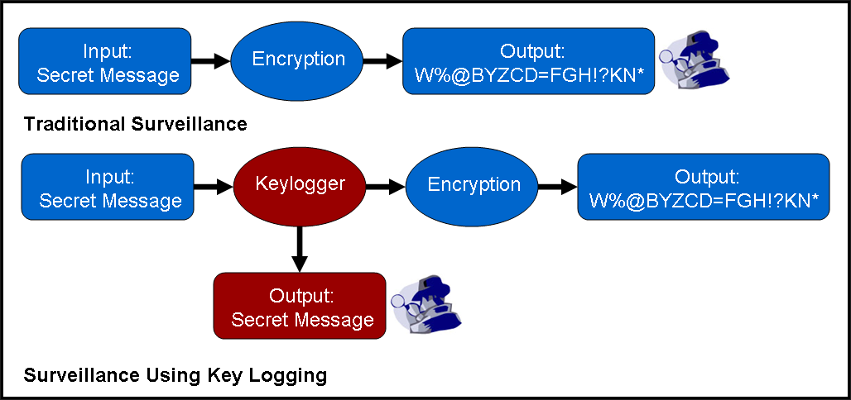
Types of Malicious Code Continued
Keylogger:
A type of surveillance technology used to monitor and record each keystroke typed on specific computer’s keyboard.

Slide 27

Types of Malicious Code Continued
Spyware:
Software that is hidden from the user in order to gather information about internet interaction, keystrokes, passwords, and other valuable data.

Slide 28

Types of Malicious Code Continued
Adware:
Designed to display advertisements on your computer and redirect your search requests to advertising websites to collect marketing data about you.

Slide 29
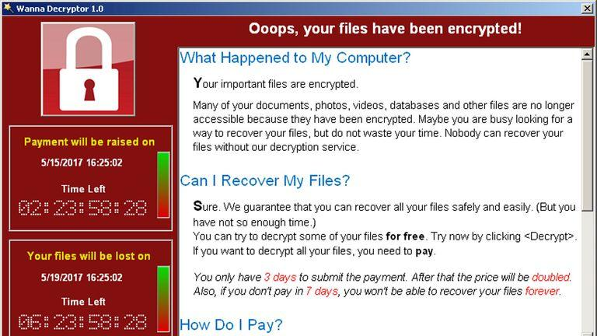
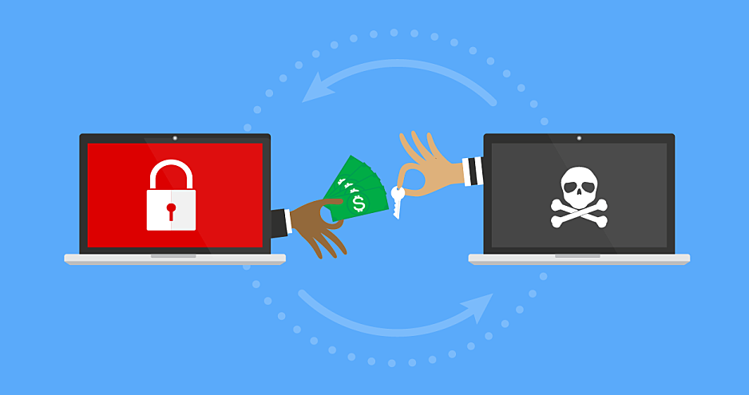
Types of Malicious Code Continued
Ransomware:
Malware that prevents or limits users from accessing their system, either by locking the system’s screen or by locking the user’s files unless a ransom is paid.

Slide 30

Vulnerabilities

Slide 31
What is a Vulnerability?
A cyber-security term that refers to a flaw in a system that can leave it open to attack.
Vulnerability is the composition of three elements:
A flaw in system.
Access of attacker to that flaw.
Capability of attacker to exploit the flaw.

Slide 32
Classification of Vulnerabilities
Vulnerabilities are classified according to the asset:
Hardware.
Software.
Network.
Personal.
Physical site.
Organizational.

Slide 33
Causes
Some of the vulnerability in the system occur due to:
Missing patches.
Cleartext credentials.
Using unencrypted channels.
RF Emanation.

Slide 34
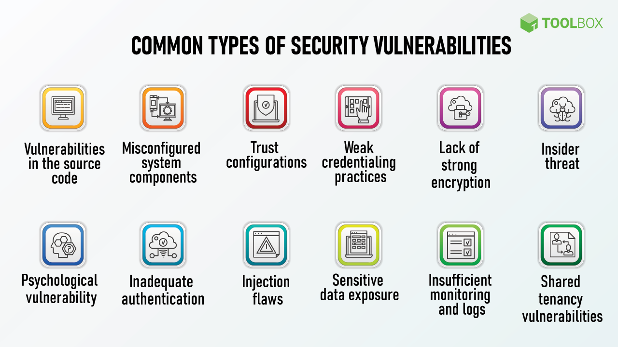

Slide 35
Thank You

